Slide 1
MACHINE LEARNING
Session – 11
Date – 13th June, 2022

Slide 2
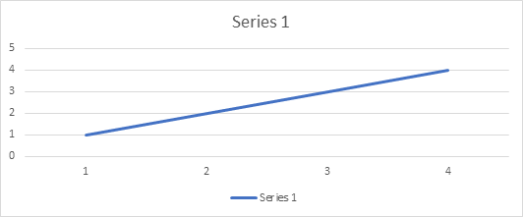
Positive Correlation
Two features (variables) can be positively correlated with each other. It means that when the value of one variable increase then the value of the other variable(s) also increases.
A positive correlation between two variables means both the variables move in the same direction. An increase in one variable leads to an increase in the other variable and vice versa.
For example, spending more time on a treadmill burns more calories.

Slide 3
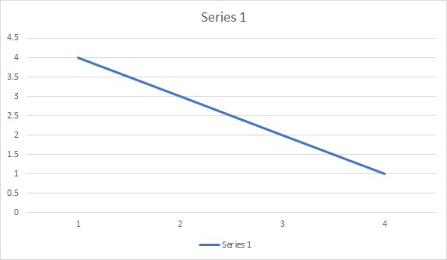
Negative Correlation
Two features (variables) can be negatively correlated with each other. It means that when the value of one variable increase then the value of the other variable(s) decreases.
A negative correlation between two variables means that the variables move in opposite directions. An increase in one variable leads to a decrease in the other variable and vice versa.
For example, increasing the speed of a vehicle decreases the time you take to reach your destination.

Slide 4
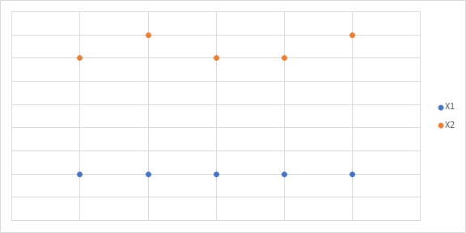
No/Weak Correlation
Two features (variables) are not correlated with each other. It means that when the value of one variable increase or decrease then the value of the other variable(s) doesn’t increase or decreases.
No correlation exists when one variable does not affect the other.
For example, there is no correlation between the number of years of school a person has attended and the letters in his/her name.

Slide 5
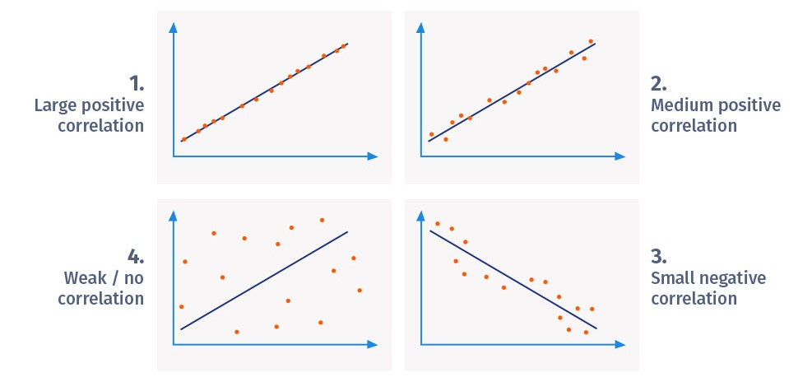

Slide 6
Uses of correlation analysis
Correlation analysis is used to study practical cases. Here, the researcher can't manipulate individual variables. For example, correlation analysis is used to measure the correlation between the patient's blood pressure and the medication used.
Marketers use it to measure the effectiveness of advertising. Researchers measure the increase/decrease in sales due to a specific marketing campaign.

Slide 7
Advantages of correlation analysis
To perform reliable correlation analysis, it is essential to make in-depth observations of two variables, which gives us an advantage in obtaining results. Some of the most notorious benefits of correlation analysis are:
Awareness of the behavior between two variables: A correlation helps to identify the absence or presence of a relationship between two variables. It tends to be more relevant to everyday life.
A good starting point for research: It proves to be a good starting point when a researcher starts investigating relationships for the first time.
Uses for further studies: Researchers can identify the direction and strength of the relationship between two variables and later narrow the findings down in later studies.
Simple metrics: Research findings are simple to classify. The findings can range from -1.00 to 1.00. There can be only three potential broad outcomes of the analysis.

Slide 8
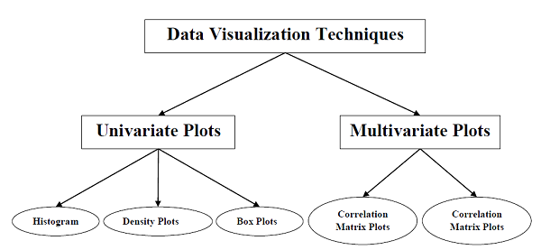
Understanding Data with Visualization
With the help of data visualization, we can see how the data looks like and what kind of correlation is held by the attributes of data. It is the fastest way to see if the features correspond to the output. With the help of following Python recipes, we can understand ML data with statistics.

Slide 9
Univariate Plots: Understanding Attributes Independently
The simplest type of visualization is single-variable or “univariate” visualization. With the help of univariate visualization, we can understand each attribute of our dataset independently. The following are some techniques in Python to implement univariate visualization −
Histograms
Histograms group the data in bins and is the fastest way to get idea about the distribution of each attribute in dataset. The following are some of the characteristics of histograms −
It provides us a count of the number of observations in each bin created for visualization.
From the shape of the bin, we can easily observe the distribution i.e. weather it is Gaussian, skewed or exponential.
Histograms also help us to see possible outliers.
Outliers are data points that are far away from other data points and they can distort the statistical result.

Slide 10
Univariate Plots: Understanding Attributes Independently
Example
pima-indians-diabetes.csv | Kaggle
The code shown below is an example of Python script creating the histogram of the attributes of Pima Indian Diabetes dataset. Here, we will be using hist() function on Pandas DataFrame to generate histograms and matplotlib for plotting them.
from matplotlib import pyplot
from pandas import read_csv
path = r"pima-indians-diabetes.csv"
names = ['Pregnancies', 'Glucose', 'Blood Presure', 'Skin Thickness', 'Insulin', 'BMI', 'DiabetesPedigreeFunction', 'Age', 'Class']
data = read_csv(path, names=names)
data.hist()
pyplot.show()

Slide 11
Univariate Plots: Understanding Attributes Independently
Density Plots
Another quick and easy technique for getting each attributes distribution is Density plots. It is also like histogram but having a smooth curve drawn through the top of each bin. We can call them as abstracted histograms.
Example
from matplotlib import pyplot
from pandas import read_csv
path = r"pima-indians-diabetes.csv"
names = ['Pregnancies', 'Glucose', 'Blood Presure', 'Skin Thickness', 'Insulin', 'BMI', 'DiabetesPedigreeFunction', 'Age', 'Class']
data = read_csv(path, names=names)
data.plot(kind='density', subplots=True, layout=(3,3), sharex=False)
pyplot.show()

Slide 12
Univariate Plots: Understanding Attributes Independently
Box and Whisker Plots
Box and Whisker plots, also called boxplots in short, is another useful technique to review the distribution of each attribute’s distribution. The following are the characteristics of this technique −
It is univariate in nature and summarizes the distribution of each attribute.
It draws a line for the middle value i.e. for median.
It draws a box around the 25% and 75%.
It also draws whiskers which will give us an idea about the spread of the data.
The dots outside the whiskers signifies the outlier values. Outlier values would be 1.5 times greater than the size of the spread of the middle data.

Slide 13
Univariate Plots: Understanding Attributes Independently
Example
from matplotlib import pyplot
from pandas import read_csv
path = r"pima-indians-diabetes.csv"
names = ['preg', 'plas', 'pres', 'skin', 'test', 'mass', 'pedi', 'age', 'class']
data = read_csv(path, names=names)
data.plot(kind='box', subplots=True, layout=(3,3), sharex=False,sharey=False)
pyplot.show()

Slide 14
Multivariate Plots: Interaction Among Multiple Variables
Another type of visualization is multi-variable or “multivariate” visualization. With the help of multivariate visualization, we can understand interaction between multiple attributes of our dataset. The following are some techniques in Python to implement multivariate visualization −

Slide 15
Multivariate Plots: Interaction Among Multiple Variables
Correlation Matrix Plot
Correlation is an indication about the changes between two variables. In our previous topic, we have discussed Correlation coefficients and the importance of Correlation too. We can plot correlation matrix to show which variable is having a high or low correlation in respect to another variable.
Example
In the following example, Python script will generate and plot correlation matrix for the Pima Indian Diabetes dataset. It can be generated with the help of corr() function on Pandas DataFrame and plotted with the help of pyplot.
from matplotlib import pyplot
from pandas import read_csv
import numpy
Path = r"C:\pima-indians-diabetes.csv"
names = ['preg', 'plas', 'pres', 'skin', 'test', 'mass', 'pedi', 'age', 'class']
data = read_csv(Path, names=names)
correlations = data.corr()
fig = pyplot.figure()
ax = fig.add_subplot(111)
cax = ax.matshow(correlations, vmin=-1, vmax=1)
fig.colorbar(cax)
ticks = numpy.arange(0,9,1)
ax.set_xticks(ticks)
ax.set_yticks(ticks)
ax.set_xticklabels(names)
ax.set_yticklabels(names)
pyplot.show()

Slide 16
Multivariate Plots: Interaction Among Multiple Variables
Scatter Matrix Plot
Scatter plots shows how much one variable is affected by another or the relationship between them with the help of dots in two dimensions. Scatter plots are very much like line graphs in the concept that they use horizontal and vertical axes to plot data points.
Example
from matplotlib import pyplot
from pandas import read_csv
from pandas.tools.plotting import scatter_matrix
path = r"pima-indians-diabetes.csv"
names = ['preg', 'plas', 'pres', 'skin', 'test', 'mass', 'pedi', 'age', 'class']
data = read_csv(path, names=names)
scatter_matrix(data)
pyplot.show()

